Slide 1

Classification and Clustering
Artificial Intelligence B Fall 2021 Assignment 2 Presentation
Hanqi Su
2021.12.30

Slide 2
OUTLINE
The purpose of this project is to achieve classification, dimensionality reduction, and clustering. Use MATLAB to program with existing tools for data mining and classification. Discuss machine learning methods and compare performances

Slide 3

1.2 Contributions
Dimensionality reduction: PCA , LDA
Clustering: K-means , hierarchical clustering, GMM
Classification: SVM, ROC curve
Hanqi Su
Robotics Engineering
11912625@mail.sustech.edu.cn

Slide 4
01 PCA
02 LDA
Principal Component Analysis
Linear Discriminant Analysis
03 Cluster
04Classification
CATALOGUE
Clustering methods
two-class classification problem

Slide 5

OVERALL FRAMEWORK
K-means
linear kernel
PCA
Clustering
Hierarchical clustering
Classification
SVM
neural network
LDA
Clustering
GMM
ROC curve
RBF kernel

Slide 6
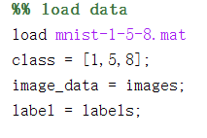
Data Preprocessing
we use MATLAAB to load the data from mnist-1-5-8.mat
image_data contains 600 images with each imgaes represented by 784x1 matrix
label contains each the number in the image
Here are three classes: number 1 , 5 , 8

Slide 7
PCA
Principal Component Analysis

Slide 8
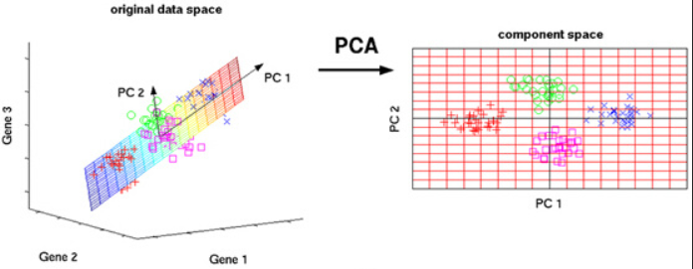
PCA Principal Component Analysis
What is PCA ?
PCA (Principal Component Analysis) is a common approach to data analysis, often used to reduce the dimensionality of high-dimensional data, and can be used to extract the main feature components of the data.
The main idea of PCA is to map the N-dimensional features to the K-dimension, which is a new orthogonal feature, also known as the principal component, which is reconstructed on the basis of the original N-dimensional features.
The work of PCA is to find a set of mutually orthogonal coordinate axes sequentially from the original space. The selection of the new coordinate axes is closely related to the data itself. Among them, the first new coordinate axis is selected in the direction of the largest variance in the original data, the second new coordinate axis is selected in the plane orthogonal to the first coordinate axis to make the largest variance, and the third axis is selected in the plane orthogonal to the first and second axes to make the largest variance. And so on, you get n of these axes.
Retaining only the dimension features containing most of the variance, while ignoring the feature dimensions containing almost zero variance, so as to achieve dimensionality reduction of data features.

Slide 9
PCA Principal Component Analysis
How to do it ?
n-dimensional to k-dimensional
Data X(m*n)
There are m* n -dimensional samples
For each column of X, subtract the mean of this column get X1
Find the covariance matrix of X1 to get C_X
Find the eigenvalues of the covariance matrix(C_X) and the corresponding eigenvectors
Get the top k largest eigenvectors to form the matrix P(n*k)
Y = X*P
Y(m*k) is the data after dimensionality reduction to k dimensions.

Slide 10
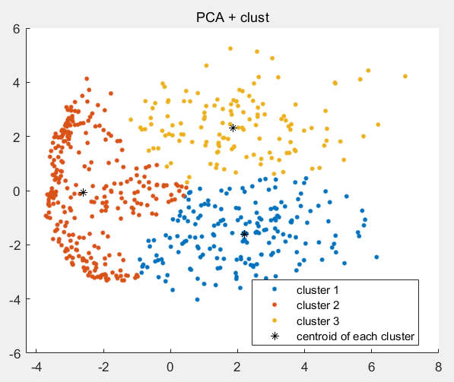
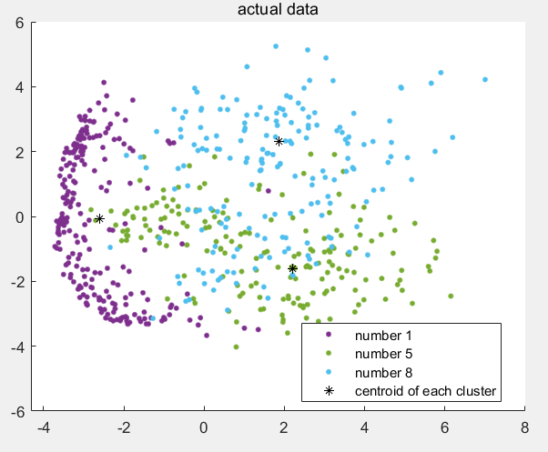
K-means
On the left is an image of the classification using PCA, and on the right is the actual distribution image. We can see that the PCA classification does not separate out certain points very well.

Slide 11
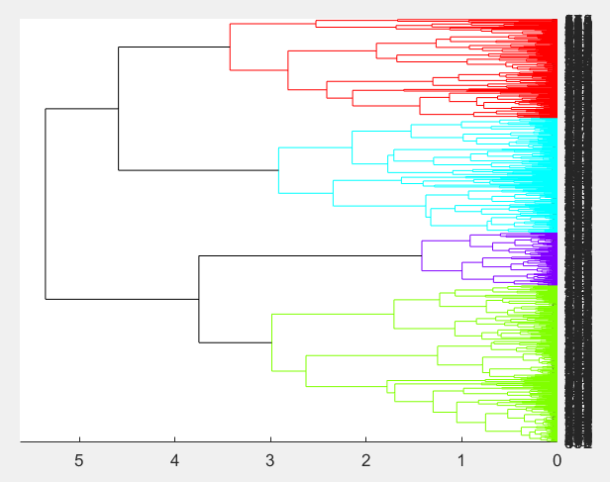
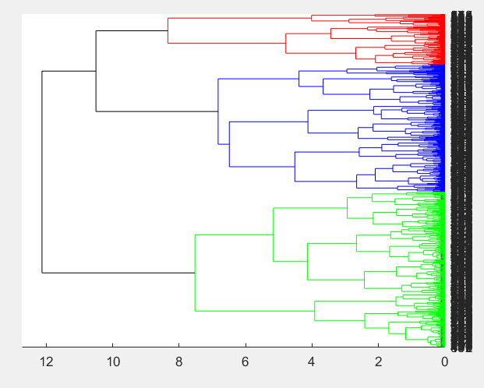
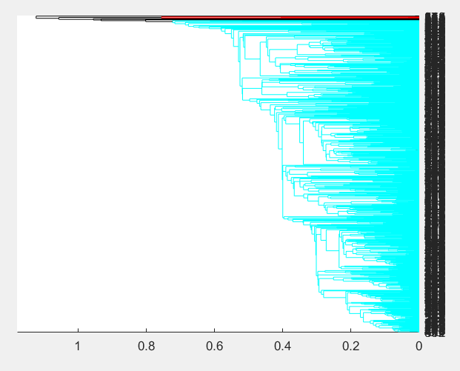
Hierarchical clustering
Linkage choose ‘average’ fit well than ‘single’ and ‘complete’ in some degree
average
single
shortest distance
complete
farthest distance

Slide 12
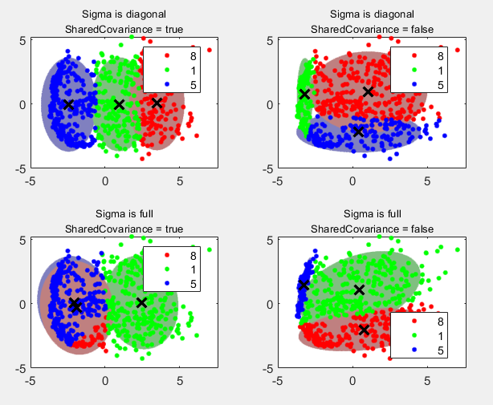
GMM
Just follow the MATLAB official guide
Sigma is diagonal
Sharecovarience = false
good

Slide 13
LDA
Linear Discriminant Analysis

Slide 14
LDA Linear Discriminant Analysis
What is LDA ?
Linear Discriminant Analysis (LDA) is a classical method for dimension reduction of supervised data.
The main idea of LDA is to project the data in a high-dimensional space to a lower-dimensional space, and ensure that the intra-class variance of each category is small and the inter-class mean difference is large after the projection, which means that after the high-dimensional data in the same category is projected to a lower-dimensional space, the same categories are grouped together, but different categories are far apart.
This is different from PCA, which is an unsupervised dimensionality reduction technique that does not take into account the output of the sample categories.

Slide 15


LDA Linear Discriminant Analysis
How to do it ?
n-dimensional to k-dimensional
Data X(m*n) and labels L(m*1)
There are m n-dimensional samples
Find intraclass scatter matrix S_w(n*n)
Find interclass scatter matrix
S_b(n*n). μ(1*n) is the vector of all sample means
Compute S_w\S_b to get S. S_w maybe a singular matrix, then we need to solve the pseudoinverse
Find the eigenvalues of the matrix(S) and the corresponding eigenvectors
Get the top k largest eigenvectors to form the matrix W(n*k)
Y = X*W
Y(m*k) is the data after dimensionality reduction to k dimensions.

Slide 16
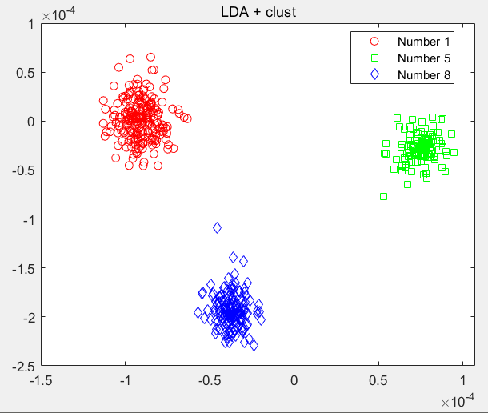
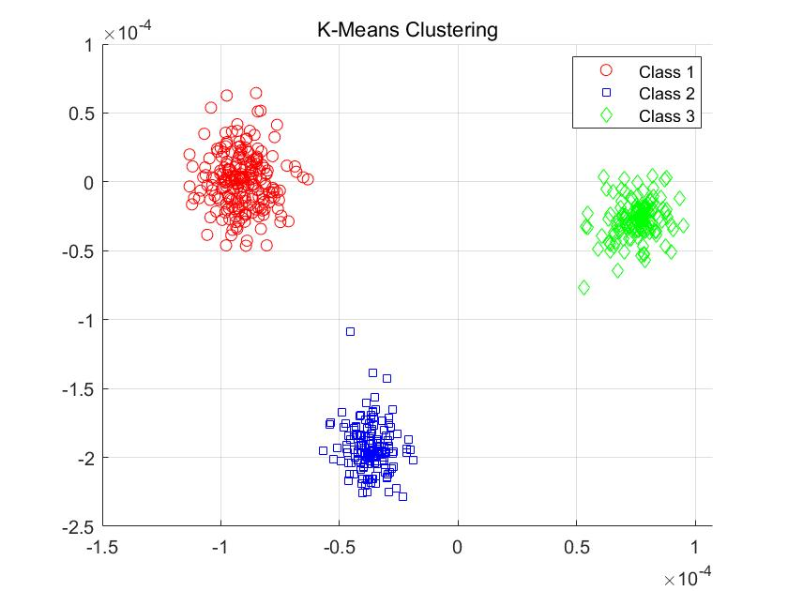
LDA + Cluster
The LDA classification looks much better than the PCA classification

Slide 17
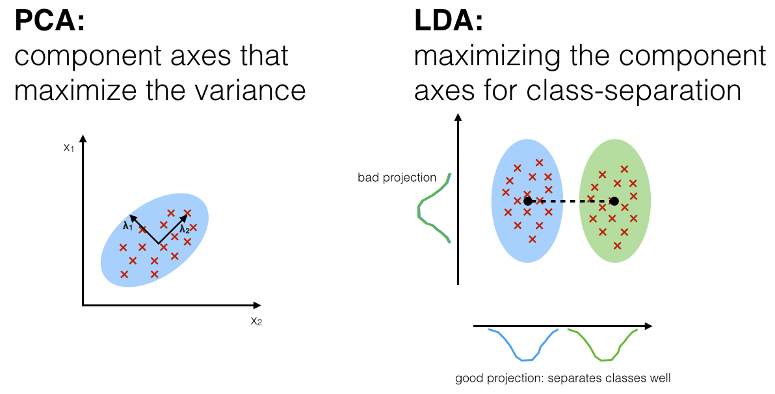
PCA & LDA

Slide 18
Clustering
Different method

Slide 19
K-means
What is K-means ?
K-means algorithm is a clustering algorithm based on partition. It takes K as the parameter to divide N data objects into K clusters, so that the similarity within the cluster is high and the similarity between clusters is low.
Process:
Firstly, k data objects are randomly selected, and each data object represents a cluster center, that is, k initial centers are selected.
For each remaining object, it is assigned to the cluster corresponding to its most similar cluster center according to its similarity (distance) to each cluster center.
The average value of all objects in each cluster is then recalculated as the new cluster center.
The above process is repeated until the criterion function converges, that is, the cluster center does not change significantly. The mean square error is usually used as a criterion function, which minimizes the sum of squares of the distances from each point to the center of the nearest cluster

Slide 20
Hierarchical clustering
What is hierarchical clustering ?
Hierarchical Clustering is a kind of Clustering algorithm, which creates a Hierarchical nested Clustering tree by calculating the similarity among data points of different categories. In a cluster tree, the original data points of different categories are the lowest layer of the tree, and the top layer of the tree is the root node of a cluster. One of the advantages of hierarchical clustering algorithm compared with partition clustering algorithm is that the clustering of data sets can be displayed at different scales (hierarchies).
There are two ways to create clustering tree: bottom-up merging and top-down merging. The hierarchical clustering algorithm can be classified as Agglomerative or Divisive.
The two approaches are not superior to each other, but in practical application, depending on the characteristics of the data and the number of "classes" you want, consider whether top-down or bottom-up is faster. The Linkage methods are the shortest, longest, middle, class average, etc. (class average is usually the most common and most useful method, on the one hand, because of its monotonicity, on the other hand, because of its space expansion/concentration degree moderate). To make up for the deficiency of decomposition and merging, hierarchical merging is often combined with other clustering methods, such as cyclic location.

Slide 21
Classification
two-class classification problem

Slide 22
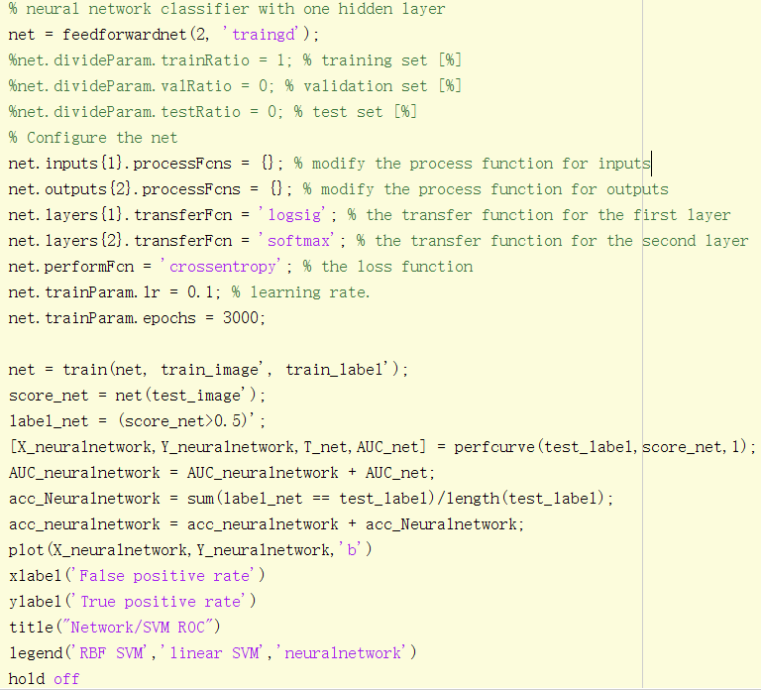
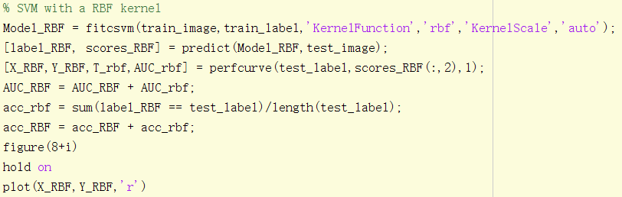
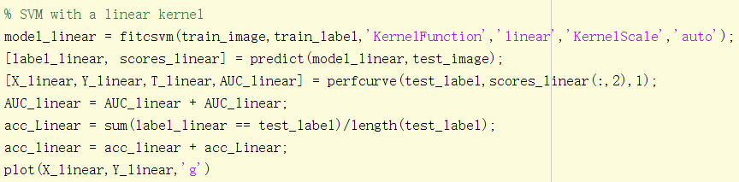
Two-class classification
Use SVM with a RBF kernel, SVM with a linear kernel, and a neural network classifier with one hidden layer to classify the dataset in a 5-fold cross validation setting
SVM with a RBF kernel
SVM with a linear kernel
a neural network classifier with one hidden layer

Slide 23
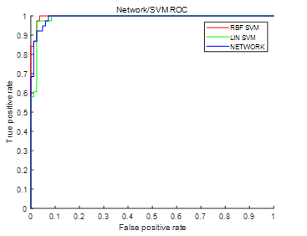
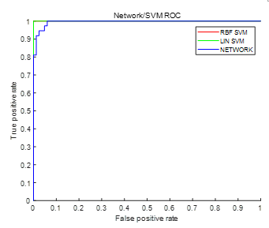
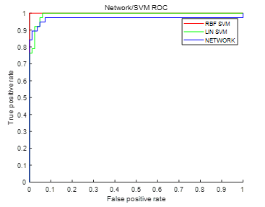
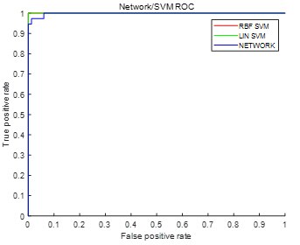
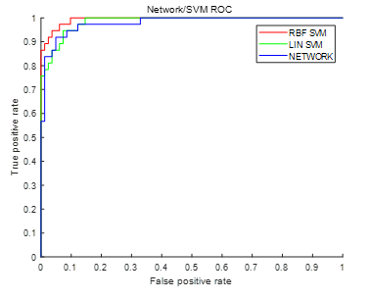
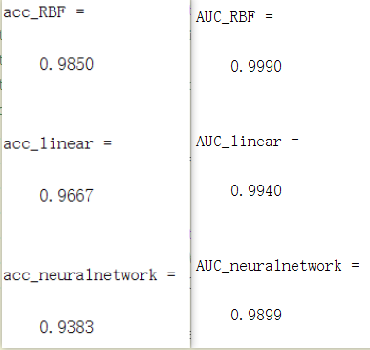
Two-class classification
The 5-fold ROC curves, average accuracy and average AUC are showed above.

Slide 24
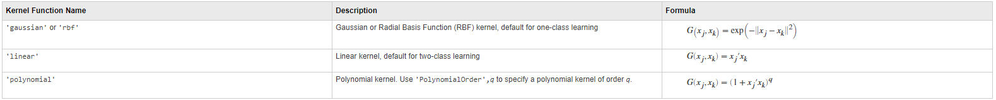
Two-class classification
It show that rbf-SVM is the best effective way to classify our data. RBF is generally used for one-class learning.
Change the parameter ‘KernelScale’, we may get a very nice accuracy.
Both linear-SVM classification methods and neural network classification methods also yielded good results

Slide 25
Two-class classification
SVM has many parameters that can be adjusted, I chose to adjust the ‘KernelScale’ parameter
I adjust the ‘KernelScale’ parameters to ‘auto’, 1and 5, then find its accuracy and draw the ROC curve

Slide 26
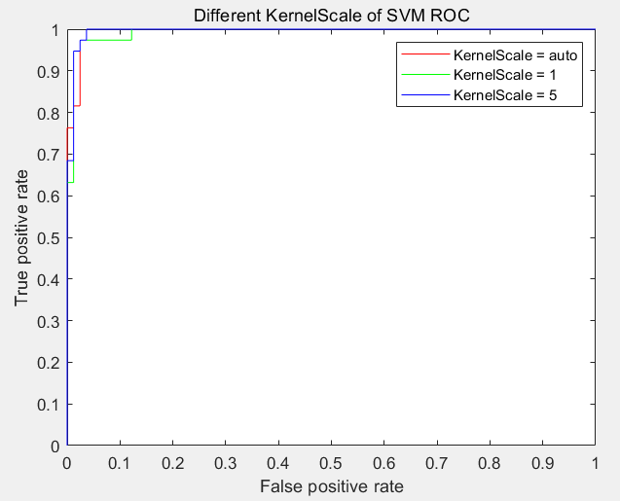
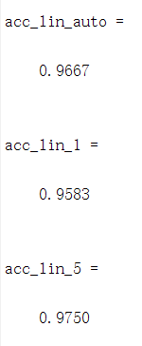
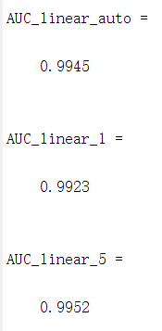
Two-class classification
The accuracy of the model when ‘KernelScale’ value is ‘auto’ and 5 is better than the value is one. When we take care of AUC, 5 is the best value above the three values.

Slide 27
Summary
mainly implemented
classification, dimensionality reduction, and clustering
Using PCA & LDA to do the dimensionality reduction
Using K-means & hierarchical clustering to do the clustering
Using SVM with a RBF kernel, SVM with a linear kernel, and a neural network classifier with one hidden layer to classify the dataset in a 5-fold cross validation setting + ROC curve

Slide 28
Thanks for Listening
Q&A
x
Hanqi Su, 2021.12.30
Classification and Clustering
Artificial Intelligence B Fall 2021 Assignment 2 Presentation

